Slide 1
NASA Vestibular Chair
Kent Wilson,
Brandon Boyle,
Noah Reid,
Matthaeus Gebauer,
Miles Osborne,
Dylan Prothro

Slide 2
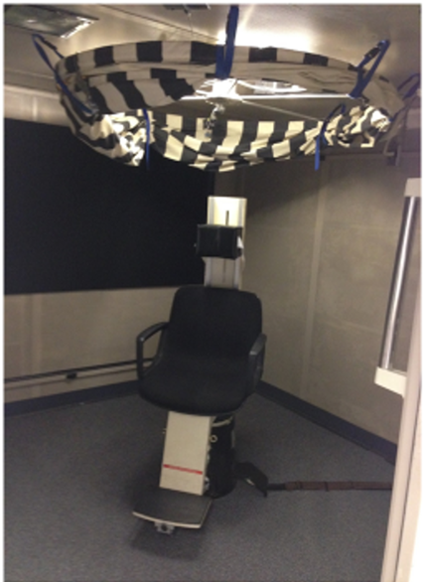
Overview
The NASA Vestibular Chair restoration project is an attempt to restore and expand functionality to a device used by NASA to test the vestibular system.
ERAU was chosen to be the new home for the chair and to conduct vestibular neuroscience research upon its restoration
Astronauts have sat in the chair too!

Slide 3
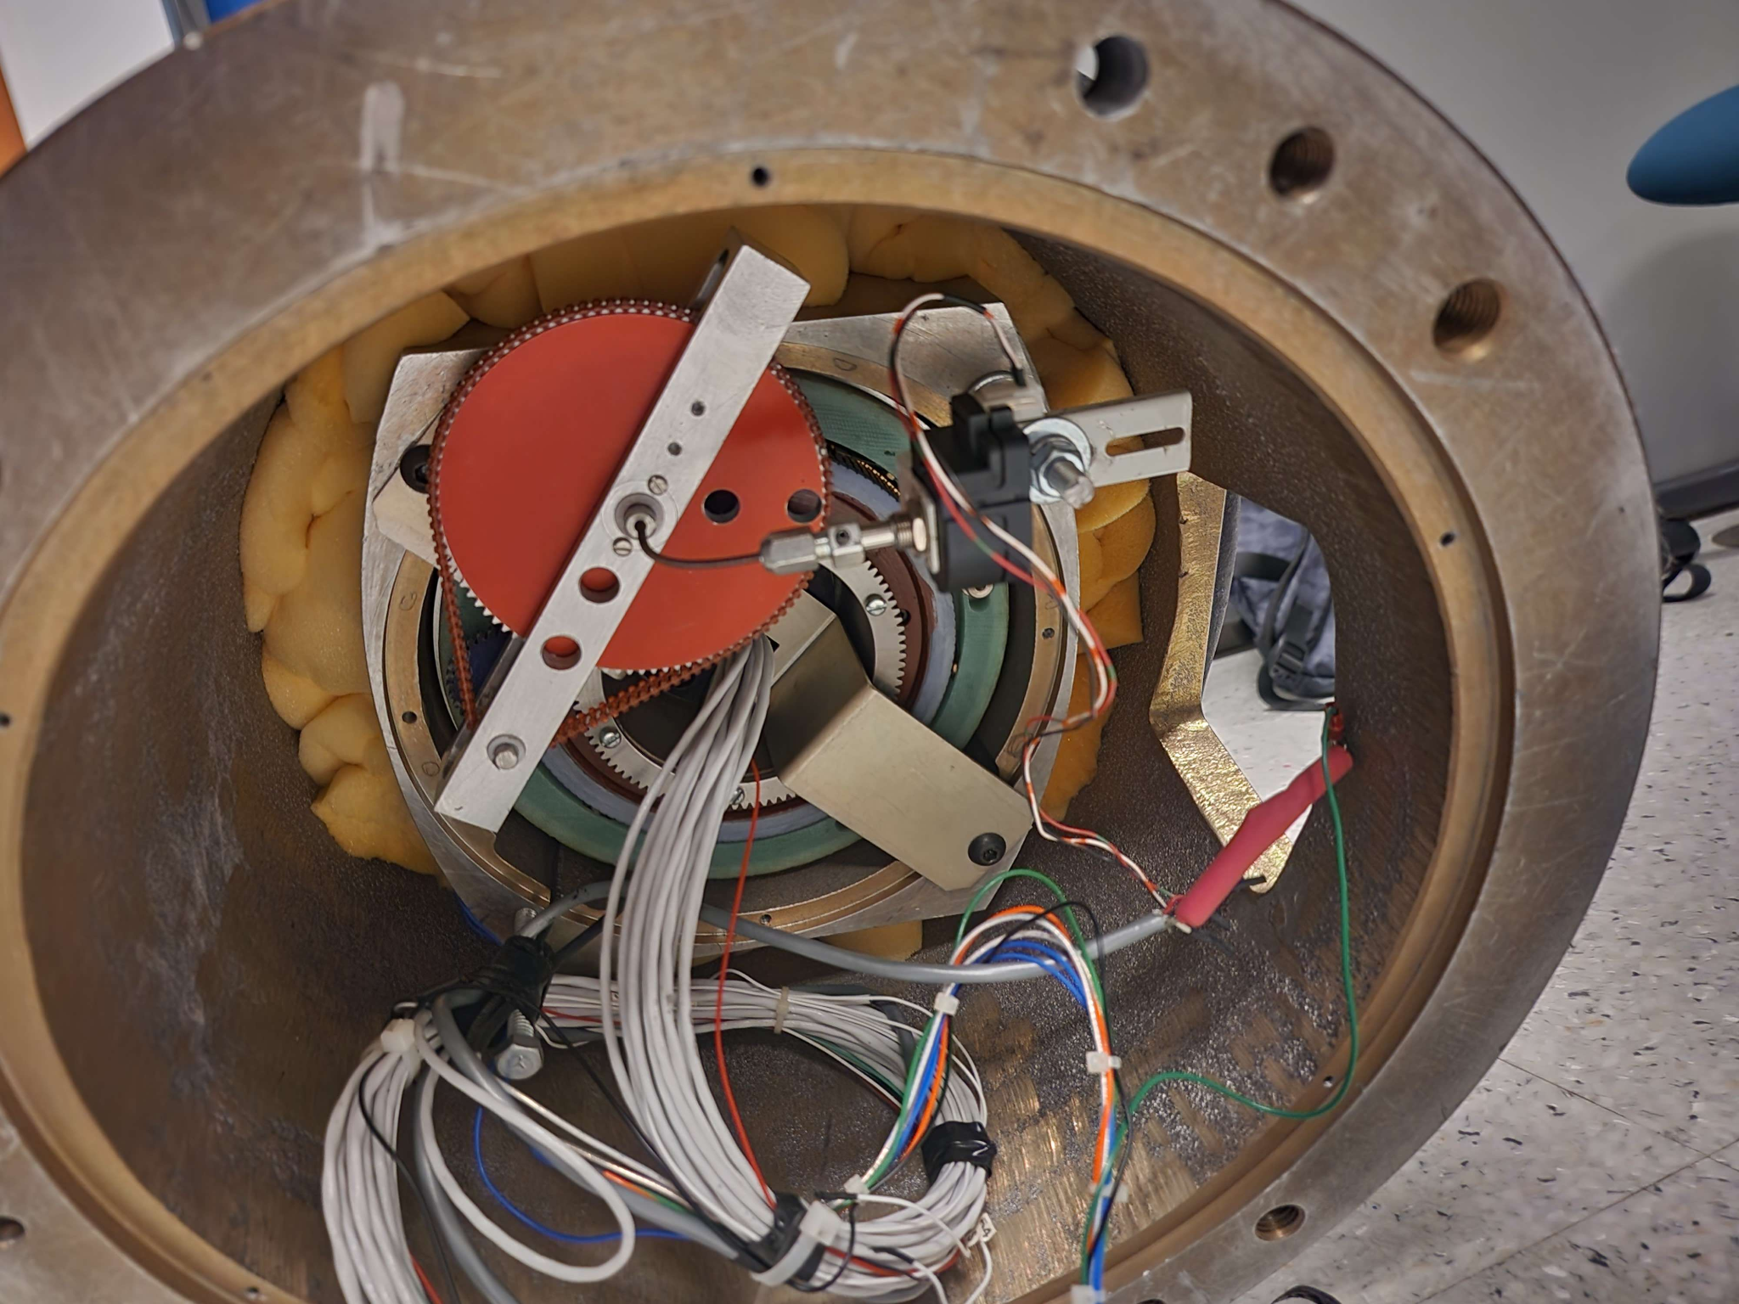
Initial Problems & Concerns
Upon initially seeing the chair, it was uncertain if the internal components were still functional.
Other problems encountered:
The chair is very old….
Everything is analog
The original controller is lost
Not all documentation is relevant or digitized

Slide 4
Sprint 1 Timeline
Goal: Apply power to the chair and make it spin
Acquired documentation from Dr. French
Started disassembling and analyzing internals
Determined that the motor inside the chair still worked properly, as well as some question on the tachometer that was already present on the chair.
We were (eventually) able to move the chair to EFRC. It’s very heavy :(
It spins…

Slide 5

Chair Demo

Slide 6
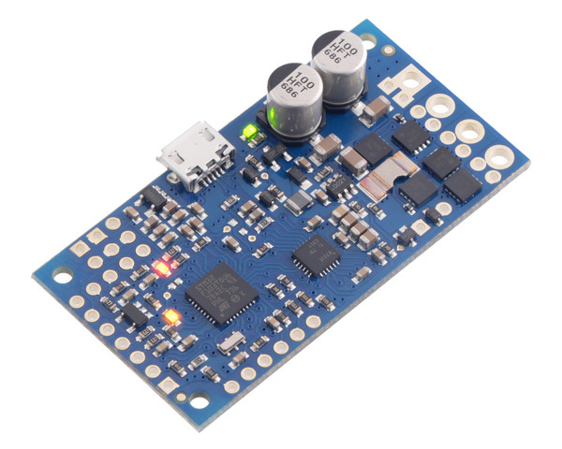
Motor Controller Progress
Dr. French needs the chair to speed up smoothly and coast without any abrupt movements. In addition, the motor direction must be reversible.
Dr. Liu recommended two controllers, and we choose the Pololu High-Power Simple Motor Controller G2 24v12.
It has every piece of functionality we desire, an intuitive user interface for initial testing, and the ability to operate the equipment through USB serial and command line instructions, which should make later web interfacing easier.
High Voltage capability
Coasting/Reverse Direction (integrated H-Bridge)
Maximum Speed configuration
If-?-Then-Kill statement configuration
A surplus of other information provided by the chip (temperature, etc…)
Given a need for a motor controller to operate the functionality of the chair’s rotation direction, a motor controller that would be able to adjust the speed and direction of the chair would be needed.
With some suggestion from Dr. Liu, the group settles on the Pololu High-Power Simple Motor Controller G2 24v12.
This was due to its high functionality as well as its intuitive Graphical User Interface.

Slide 7
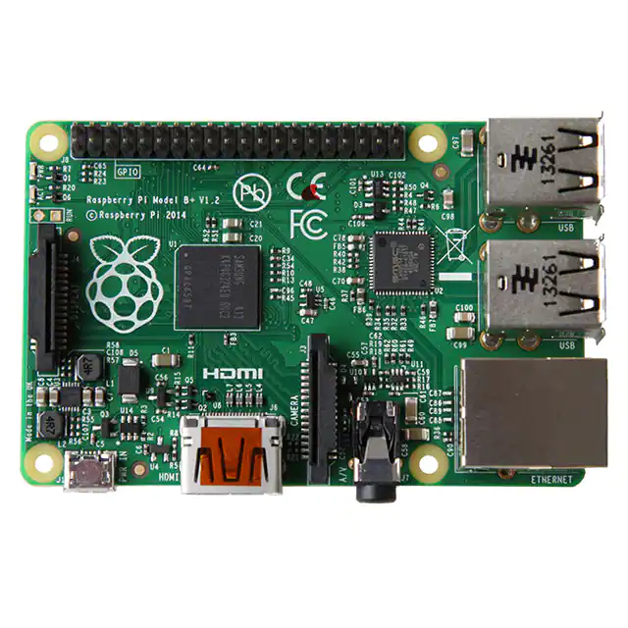
Additional Controller Considerations:
Raspberry Pi
We need at max 40 GPIO pins, a USB serial port for the controller, a USB serial port for a future directionality indicator (soon discussed), and EITHER an Ethernet port or wireless capability for a web interface.
To this end, we are currently exploring the Raspberry Pi B+ as our controller of choice, as it fits all of those needs.

Slide 8
Additional Controller Considerations:
Directionality Indicator
We need to have another discussion with Dr. French, since we need to explicitly define what the shareholder wants in terms of a directionality indicator.
At its most basic, it could be two buttons which communicate via infrared to two LEDs.
At its most advanced, it could be a mounted joystick which communicates 360 degrees of direction information wirelessly to our controller which will plot the points on a cartesian plane over time next to the rest of the experiment information.

Slide 9
Web Interface Progress
We are planning to use a python based web interface to control the raspberry PI
Some options we are exploring are:
Plotly Dash
Flexibility, not free
Tkinter
Easy and already in python standard library
Using Python makes it extremely simple to send commands via a serial protocol

Slide 10
Summary
At the end of the first sprint, our goal of having the chair move was achieved through connection of a power source at the Eagle Flight Research Center.
It was determined then that the chair needed a power source that ran up to 24V, a much lower shot from the value that had been determined through the leftover manuals for operation of the device.

Slide 11
Where We Are Going
Sprint 2 Goal: Acquire suitable power supply and independently power it
Purchase and install new motor controller
Purchase compatible microcontroller to be compatible with both
Attempt to restore basic functionality with these three components
Secondary Goal: additional time: Simulate/demo a test sequence with the official or equivalent microcontroller
Areas for Improvement:
Sprint planning
Communication w/ shareholders
No more hurrications….

Slide 12
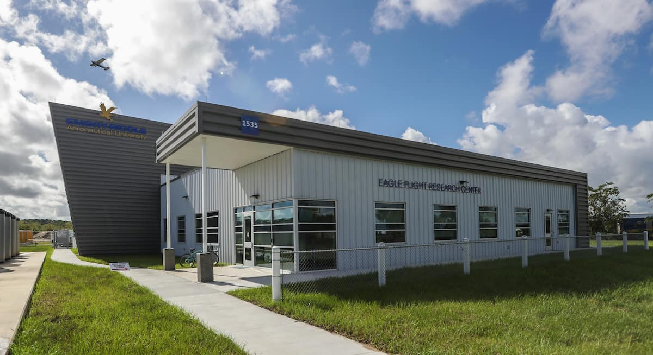
Special Thanks

